Slide 1
Reinforcement Learning
Proximal Policy Approximation (PPO)
Daniel Della Vecchia, Kevin Wang, Kushal Bhandari,
Roman Vakhrushev, Vijay Sadashivaiah

Slide 2
Original Paper
“Proximal Policy Optimization Algorithms” by Schulman et. al.
OpenAI: https://openai.com/blog/openai-baselines-ppo/
Github: https://github.com/openai/baselines
ArXiv: https://arxiv.org/abs/1707.06347

Slide 3
Overview
What is Reinforcement Learning? Setup: Environment, State, etc.
Why RL is an optimization problem?
On-Policy (Model Free) vs Off-Policy RL (Model Based)
Policy Gradient Methods and Trust Region Methods
Proximal Policy Optimization
Experiments
Problem Set

Slide 4

What is Reinforcement Learning?
Reinforcement learning is a machine learning paradigm in which an agent interacts with an environment with the goal of learning to maximize its cumulative reward.
The agent learns by taking actions, which it chooses using prior knowledge, or randomness (called exploration), and then receiving a reward.
Using this result, the agent updates its policy to favor actions that increase reward, and to avoid actions that decrease reward.

Slide 5
Reinforcement vs Supervised Learning
Reinforcement learning is a sequential learning paradigm
Current input → Decision → Impacts future inputs and decisions
In supervised learning, future decisions are independent of current inputs
For instance, current batch does not impact next batch
Example:
Supervised Learning:
Using labelled data of student’s performance to predict salary
Reinforcement Learning:
Robot navigating an unknown environment by interacting and learning over time

Slide 6
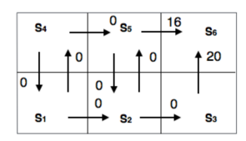
Reinforcement Learning as MDP
A typical way to model a RL problem is by a Markov Decision Process (MDP)
MDP consists of:
S - set of states the agent can be in (individual states are denoted by s)
A - set of possible actions of the agent (individual actions are denoted by a)
- probability of transition at time t from state s to state s’ under action a
R_{a}(s,s’) - immediate reward after transition from s to s’ with action a (individual rewards are sometimes denoted by r)
Some starting state s₀ or s₁
Sometimes, there are terminal states (episodic RL), or no terminal states (continuous RL)

Slide 7
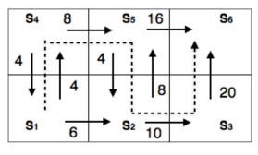


Policy in Reinforcement Learning
In Reinforcement Learning P and R are not known to the learning agent, however, at each time t, the agent knows its state s_{t} and r_{t}
Define a deterministic policy , that is a function that maps all states to some actions
We can also define a stochastic policy as follows:
The eventual goal of Reinforcement Learning is to find an optimal policy 𝜋* s. t. expected cumulative reward is maximized
Policies can be parameterized according to some set of parameters 𝜃. A policy is then written as 𝜋_{𝜃} .
Ex:
Possible policy 𝜋₁: 𝜋₁(s₁) = →, 𝜋₁(s₂) = ↑, 𝜋₁(s₃) = ↑, 𝜋₁(s₃) = ↑,
𝜋₁(s₄) = ↓, 𝜋₁(s₅) = ↓
Optimal policy 𝜋*: 𝜋*(s₁) =↑,
𝜋*(s₂) =→, 𝜋*(s₃) =↑, 𝜋*(s₄) =→,
𝜋*(s₅) =↓

Slide 8





Reinforcement Learning as an Optimization Problem
Define , the expected cumulative reward an agent would receive following policy 𝜋 starting from state s. is called the state-value function for policy 𝜋.
Similarly, we can define . is called the action-value function for policy 𝜋.
Ideally, the goal is to find .

Slide 9
On-Policy vs Off-Policy RL
As you know, in RL an agent takes actions and learns from them in adjusting its policy. In on-policy methods, these actions are influenced/determined by the policy itself, which is adjusted after the actions are taken. In off-policy methods, the agent uses another process to take actions, and the learned information can be used to construct main agent’s policy.
Off-policy RL:
Slower
Can’t handle stochastic environments
On-policy RL:
Quicker
Can handle stochastic environments
Examples:
On-policy
REINFORCE
State-action-reward-state-action (SARSA)
Trust Region Policy Optimization (TRPO)
Proximal Policy Optimization (PPO)
Off-Policy RL:
Q-learning
Notes:
https://www.quora.com/What-is-difference-between-off-policy-and-on-policy-in-reinforcement-learning

Slide 10
Off and On-Policy Algorithm Examples
Off-policy example - Q-Learning:
Define Q(s,a) to be the expected maximum cumulative reward an agent can receive given it is in state s and takes action a. Then whenever the agent is in state s and takes action a, transitioning into state s’, Q(s,a) is updated as follows:
Where γ is the damping coefficient, α is the learning rate, and a’ is an arbitrary action that can be taken from state s’. The action a selected does not depend on the policy.
The equation above implies Q is simply a table. In Deep Q-Learning, Q is approximated with a feedforward deep neural network.
On-policy example - SARSA:
The SARSA algorithm is very similar to Q-Learning. However, in SARSA, a and a’ are chosen by the policy. While in state s, the agent uses its policy to select action a, moving from state s to s’. Then, a’ is the action chosen by the policy in state s’. Q(s, a) is updated as follows:
Notes:
https://stats.stackexchange.com/questions/184657/what-is-the-difference-between-off-policy-and-on-policy-learning

Slide 11
RL Applications
Typically, RL requires very dense rewards. In many real-world scenarios, an agent faces the challenge of sparse extrinsic reward, leading to a problematic and challenging objective to solve. A sparse reward task is typically characterized by a meagre amount of states in the state space that return a feedback signal. A typical situation is a situation where an agent has to reach a goal and only receives a positive reward signal when it is close enough to the target.
Reward-shaping: method for engineering a reward function in order to provide more frequent feedback on appropriate behaviors.
Example: number of extra chess pieces in chess
Problems:
Reward functions are often hand-crafted and require human experts to be successful
Human bias to the possible policies that the agent will find to solve this problem
Agent might fail to discover new policies humans haven’t found yet
Notes:
https://medium.com/@m.k.daaboul/dealing-with-sparse-reward-environments-38c0489c844d

Slide 12
Curiosity Driven Methods
Agent predicts the next state, given the current state and selected action. The deviation between this prediction and the actual state is used to measure “novelty”. This deviation is added to the agent’s intrinsic reward through a feedback system, to incentivize more exploration.
Policy is trained to optimize the sum of the extrinsic reward provided by the environment, and the curiosity based intrinsic reward.
Notes:
https://www.youtube.com/watch?v=_Z9ZP1eiKsI

Slide 13
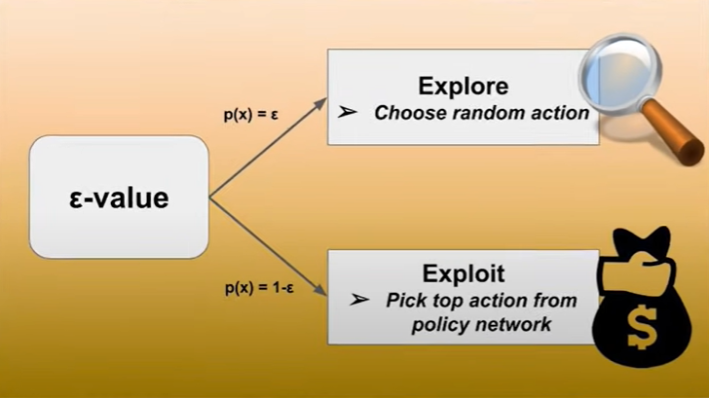
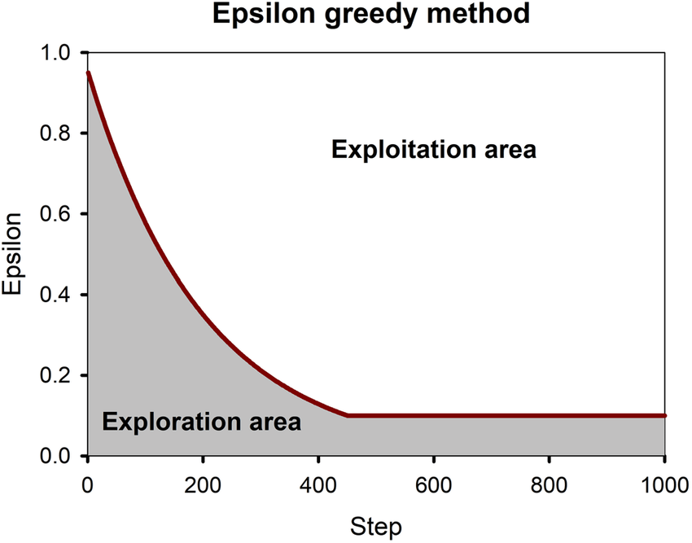
Greedy Policy vs. Exploration
ε Greedy Policy - Agent constantly perform the action that is believed to yield the highest expected reward.
ε-value is the probability the agent of exploring. Range [0,1]
ε diminishes after each step, and, agent will follow a
greedy policy more closely.
Problem: Agent can get stuck with small, recurring rewards
Notes:
https://www.youtube.com/watch?v=_Z9ZP1eiKsI

Slide 14









Policy Gradient Algorithms
In policy gradient algorithms, the policy is parameterized using some set of parameters as .
Then, a policy can be evaluated using some objective function .
Policy gradient algorithms optimize using the gradient and searching for the optimal set of parameters
and are estimated via the agent’s prior knowledge and interaction with the environment
Important definition: A length-T trajectory is a sequence of actions taken under the policy as well as the corresponding states .

Slide 15









Vanilla Policy Gradient (VPG)
For any trajectory , let , where . That is, the expected total
reward gained in following . Vanilla policy gradient aims to maximize the expected value of this over all trajectories: .
It can be proven mathematically that this is equivalent to maximizing , where is the advantage of performing in state , and is an arbitrary timestep from an arbitrary trajectory. Using a finite sample of timesteps gained by interacting with the environment, the objective becomes:
Which has gradient .
Empirical evaluations show using this gradient for more than one epoch is often destructive to the policy, rendering VPG data-inefficient.

Slide 16






Trust Region Policy Optimization (TRPO)
Trust Region Policy Optimization (TRPO) uses “surrogate” (temporary) objective functions that are based on a temporary fixed policy , which is replaced by newer policies as the policy is updated. It can be shown that optimizing is about equivalent to optimizing
So long as is refreshed frequently enough.
TRPO maximizes this objective under the constraint , where is KL-divergence and is a positive hyperparameter.
TRPO updates the policy to favor positively rewarded actions based on prior experience, but only within a ‘trust region’, i.e., the policy cannot become too different from . is updated with the new policy when the surrogate objective is maximized under the constraint.
Unfortunately, TRPO is very sensitive to hyperparameter tuning, complicated, and incompatible with noise-based architectures.

Slide 17
The Authors’ Proposal: Proximal Policy Optimization (PPO)
A family of policy gradient methods aimed to optimize data-efficiency, complexity, and generality.

Slide 18

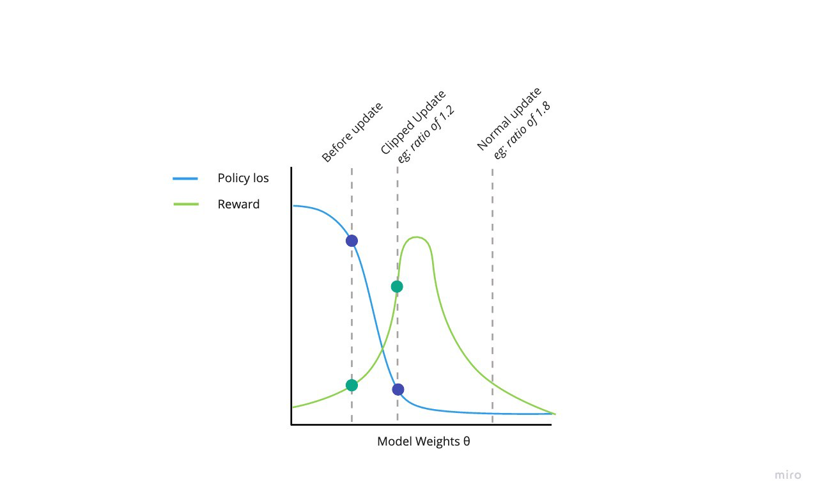


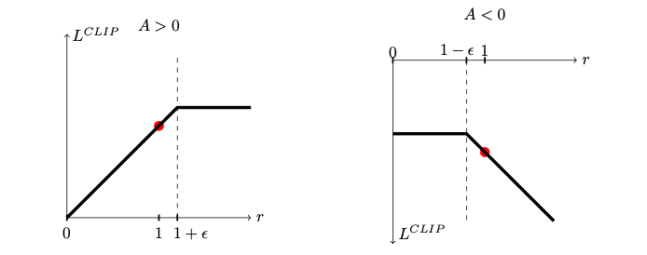
A Central Proposal: The Clipped Objective
Let the probability ratio .
Optimize the following surrogate objective:
is a pessimistic bound on the performance of the policy and via the clipping prevents it from diverging from the policy more than indicated by the hyperparameter .
This surrogate objective can be optimized for several epochs, rendering PPO more data-efficient than VPG.

Slide 19












Another Area of PPO: TRPO with Adaptive KL Penalty
While standard TRPO optimizes under the constraint , where
is the KL-divergence between and , the authors propose using as a penalty instead of a constraint; i.e., maximize
However, a fixed has been empirically shown to be insufficient. The authors therefore also propose adapting such that each time is optimized,
Where is some target KL-divergence. can be an alternative to .

Slide 20





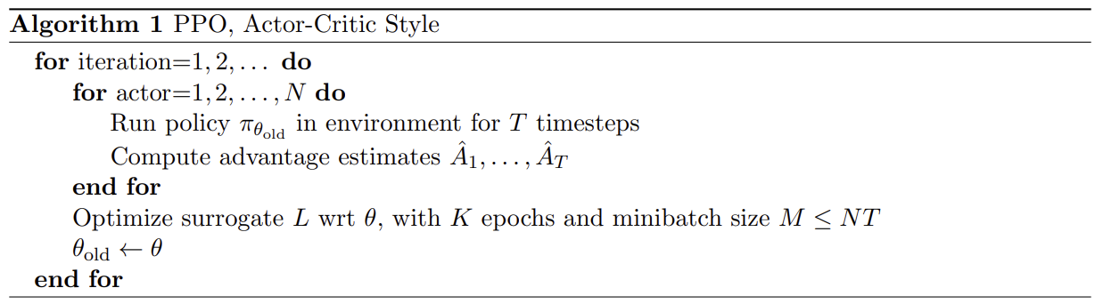
PPO Implementation, Actor-Critic Style
actors, each of which follow a length- trajectory according to , resulting in timestep samples.
is either or .

Slide 21
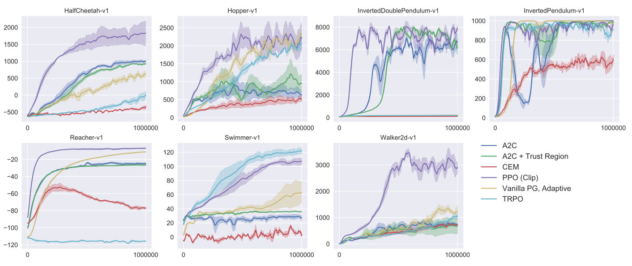
Results: MuJoCo environments

Slide 22
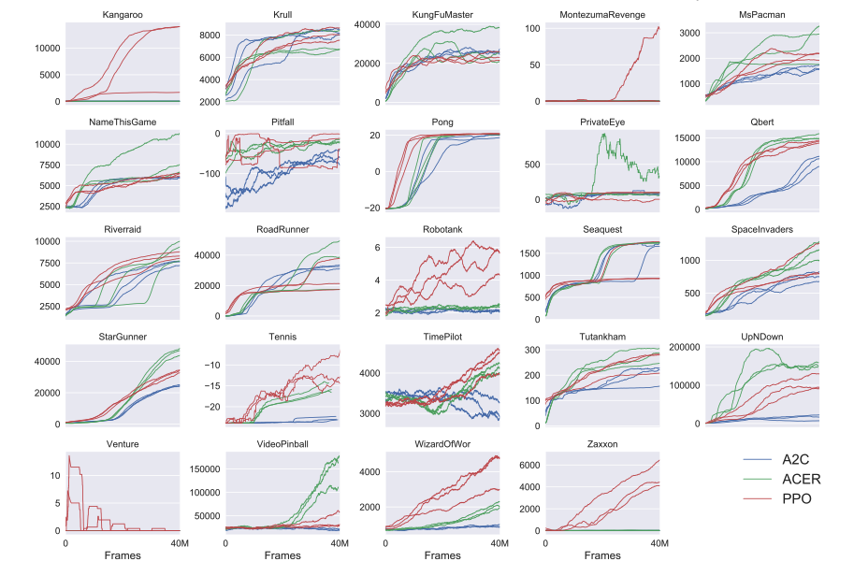
Results: Atari games

Slide 23
Experiment: CartPole-v1
A pole is attached by an un-actuated joint to a cart, which moves along a frictionless track.
The pendulum starts upright, and the goal is to prevent it from falling over by increasing and reducing the cart's velocity.
Observations: Cart Position, Cart Velocity, Pole Angle, Pole Angular Velocity
Actions (Discrete): 0 (push left) or 1 (push right)
Reward: 1 for every step
Terminates:
Angle > 12 degrees
Cart Position > 2.4 (EOD)
Num Episodes > 200
Solved when reward reaches 195

Slide 24
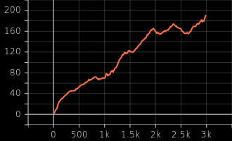
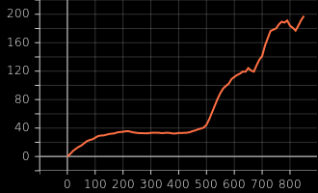
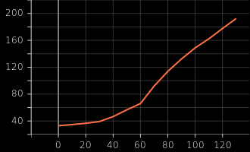
Experiment: CartPole-v1
REINFORCE
TRPO
PPO

Slide 25
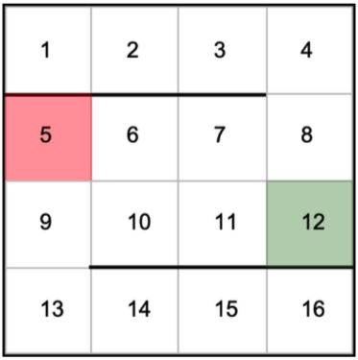
Problem Set
Formulate GridWorld as MDP:
Given states, actions, rewards and discount factor
Solve the GridWorld problem manually:
Derive optimal Value Function under different constraints
Implementation on the GridWorld problem:
Implement Value Iteration function for the GridWorld Problem
Implement Policy Iteration function for the GridWorld Problem
Link to the Problem Set

Slide 26
Citations
https://towardsdatascience.com/reinforcement-learning-101-e24b50e1d292
http://www.scholarpedia.org/article/Policy_gradient_methods
https://www.cs.rpi.edu/~xial/Teaching/2021SAI/
https://stackoverflow.com/questions/46422845/what-is-the-way-to-understand-proximal-policy-optimization-algorithm-in-rl

Slide 27
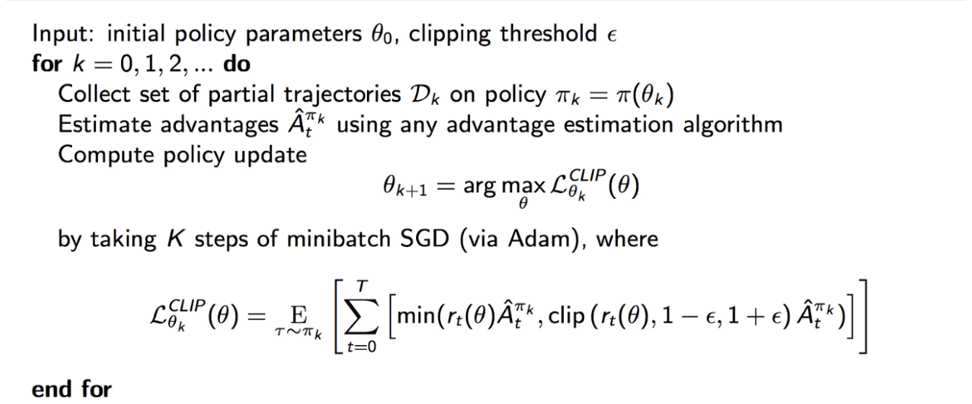
PPO with Clipped Objective

Slide 28
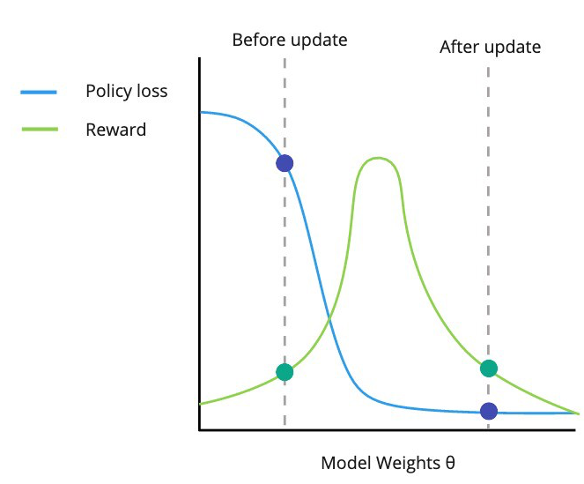
Problem with large gradient update

Slide 29
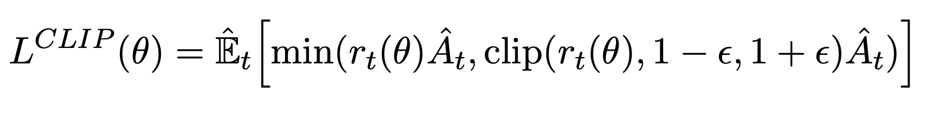
Clipped objective

Slide 30
What is Reinforcement Learning
Environment
State
Reward
Policy
Value

Slide 31

On-Policy vs Off-Policy RL
On-policy methods estimate the value of a policy while using it for control.
In off-policy methods, the policy used to generate behaviour, called the behaviour policy, may be unrelated to the policy that is evaluated and improved, called the estimation policy.
An advantage of this seperation is that the estimation policy may be deterministic (e.g. greedy), while the behaviour policy can continue to sample all possible actions.
On-policy RL
Q-learning: Off-policy
On-Policy learning algorithms are the algorithms that evaluate and improve the same policy which is being used to select actions.

